Slide 1

Create a model for Forecasting

Slide 2
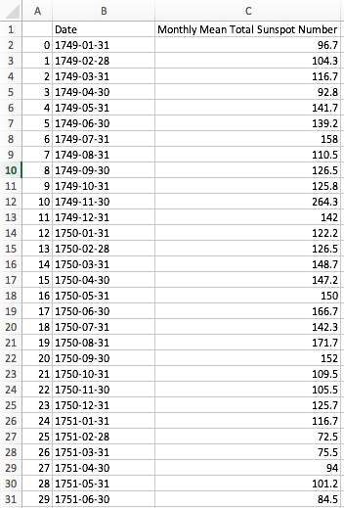
Objectives
Lab 4: Create a model for Forecasting.
Dataset:
  Sunspots.cvs
  Download dataset: !wget https://storage.googleapis.com/tensorflow-1-public/course4/Sunspots.csv

Slide 3
Q & A

